Slide 1
Model Training Results

Slide 2
Base Model

Slide 3
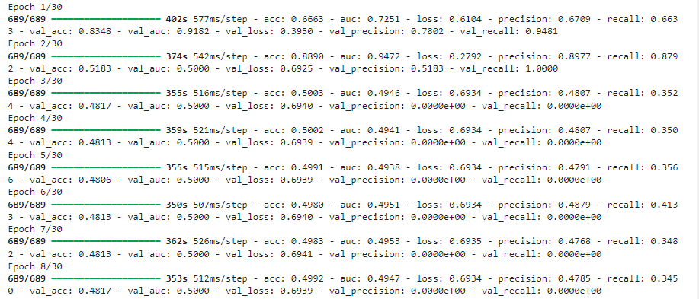

Slide 4
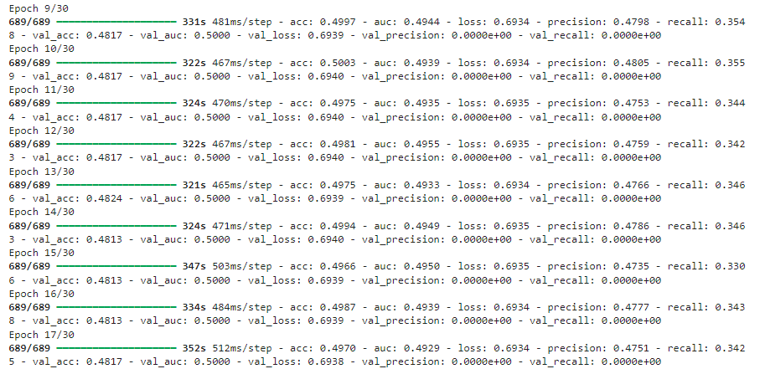

Slide 5
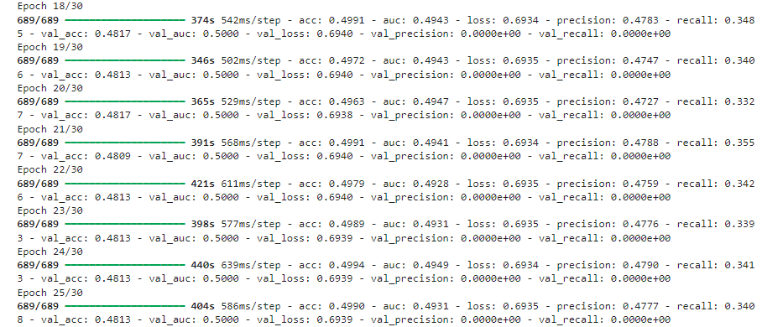

Slide 6


Slide 7
Second Model

Slide 8


Slide 9
Third Model

Slide 10
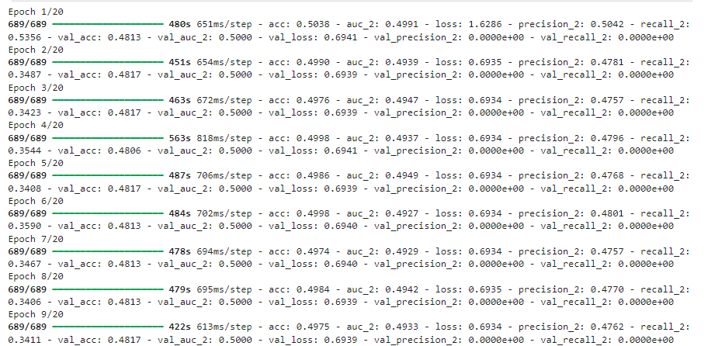

Slide 11
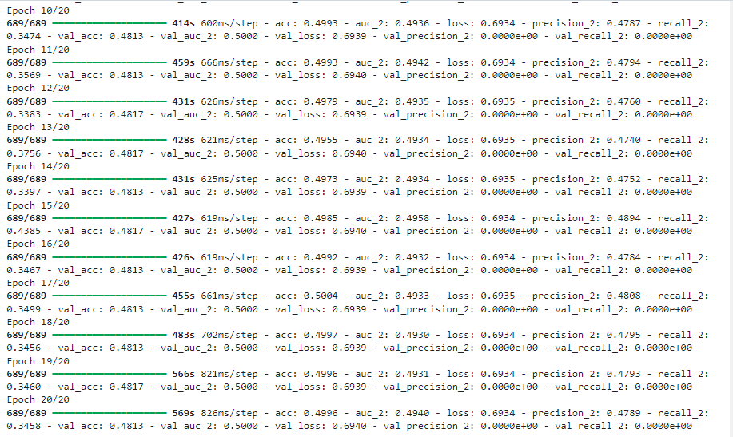

Slide 12
Fourth Model

Slide 13


Slide 14
Evaluation on Unseen Data

Slide 15


